Slide 1
HW3
Shaojie Carter Zhang

Slide 2
Generate Training and Testing Data
Load in CR2
rng(338);
n = 300;
newdata = datasample(CR2(1:3802, :), 300);
joined = [newdata; CR2(3803:3932, :)];
rng(438);
testdata = datasample(CR2(1:3802, :), 400);
testdata = [testdata; CR2(3803:3932, :)];

Slide 3
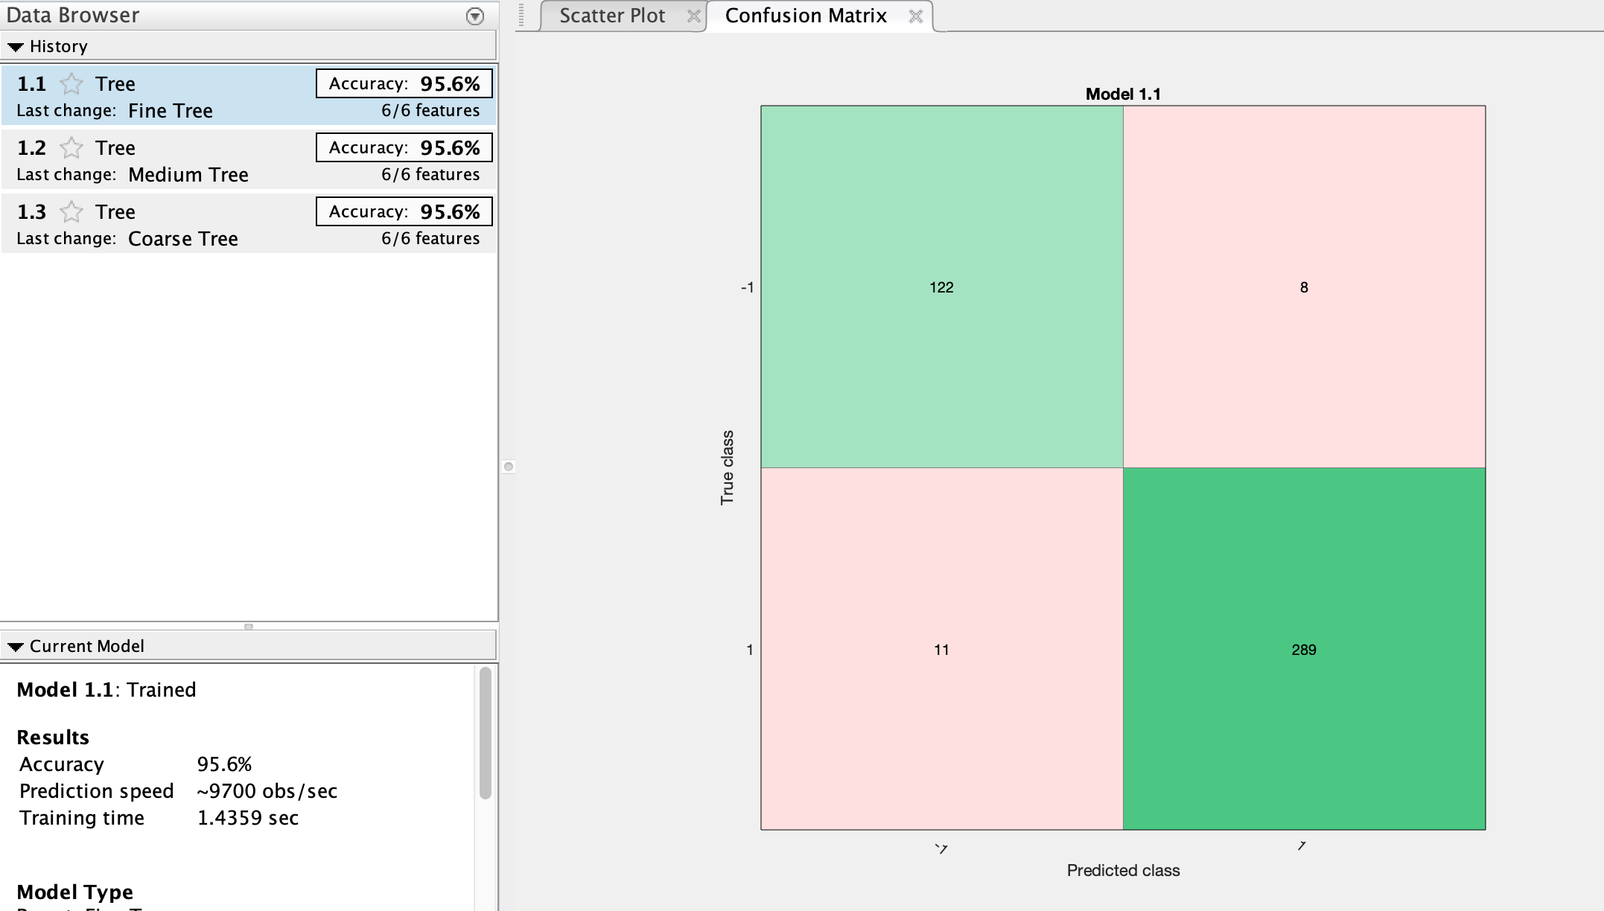
1. Simple Decision Tree Train (In sample)
Note that we do this with 2 fold

Slide 4
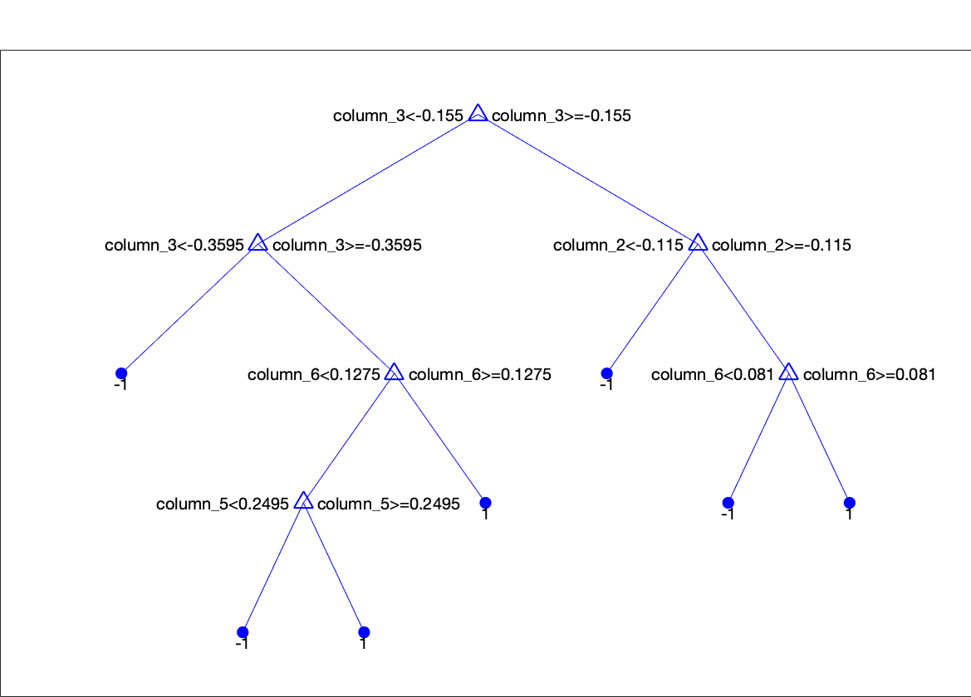
Simple Tree Train (In Sample) view(SimpleTree.ClassificationTree, 'Mode', 'Graph')

Slide 5
2. Optimized Decision Tree
optT_pred = SimpleTree.ClassificationTree.X;
optT_resp = SimpleTree.ClassificationTree.Y;
OptTree = fitctree(optT_pred, optT_resp, 'OptimizeHyperparameters', 'auto’);
view(OptTree, 'Mode', 'Graph')

Slide 6
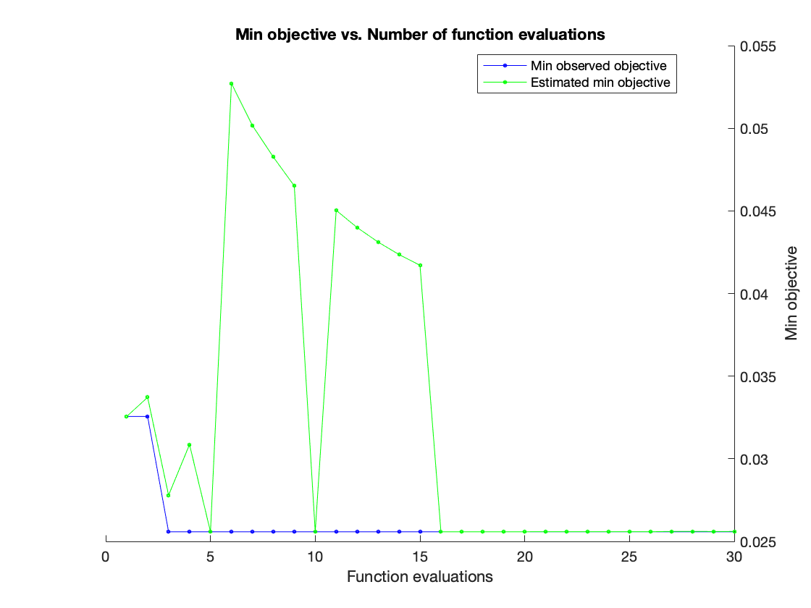
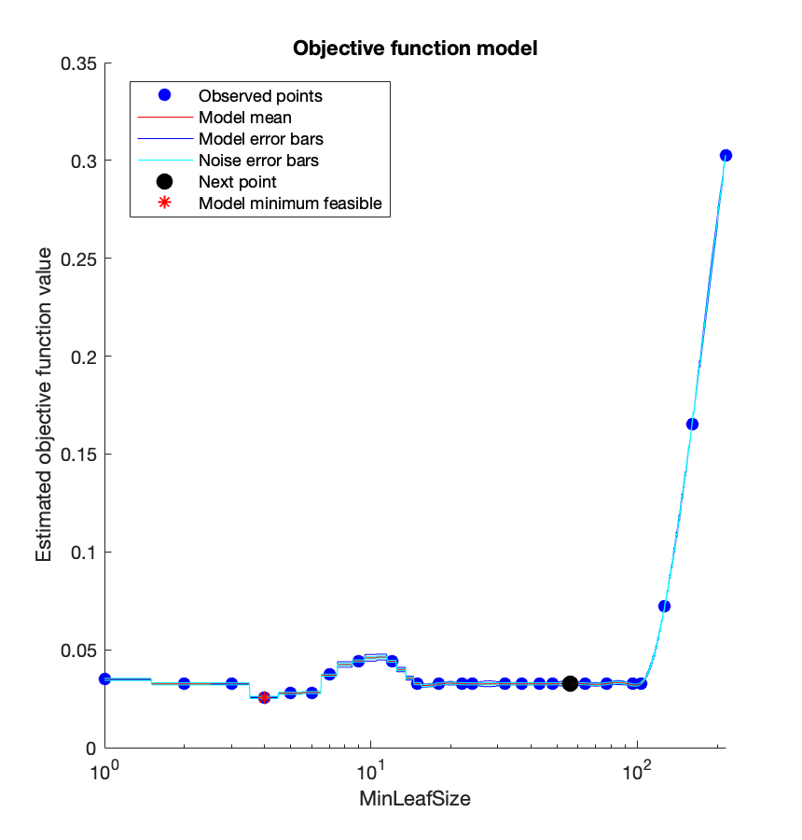
Optimized Decision Tree (In Sample)

Slide 7
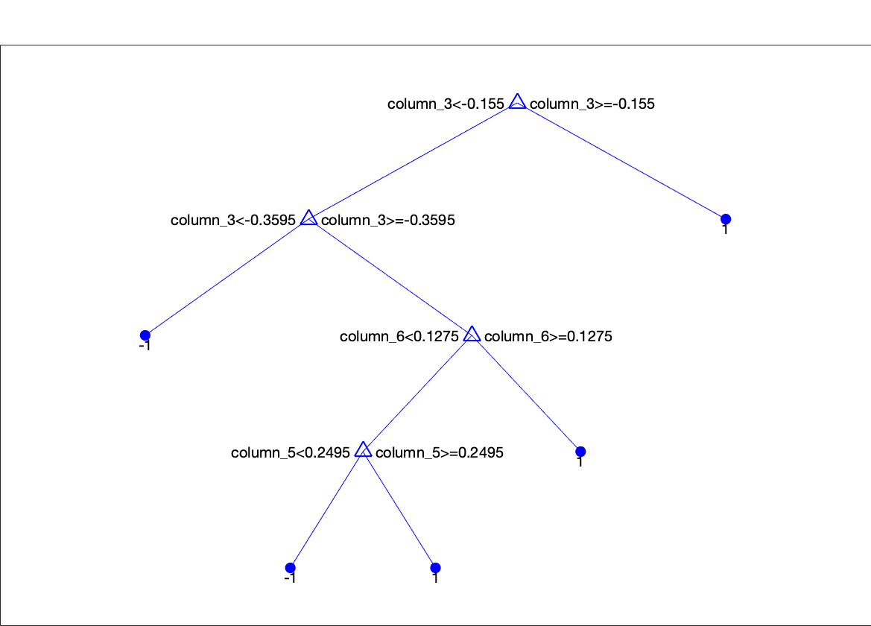
Optimized Decision Tree (In Sample)

Slide 8
3. Bagged Tree Ensemble
bagX = joined(:,2:7);
bagY = joined(:,9);
ens = fitcensemble(bagX, bagY, 'Method', 'Bag');
[label_ens,score_score_ens] = oobPredict(ens);
bagZ=num2cell(bagY);
bagZZ=cell2mat(bagZ);
confusionmat(bagZZ,label_ens)
view(ens.Trained{1,1},'Mode','graph')

Slide 9
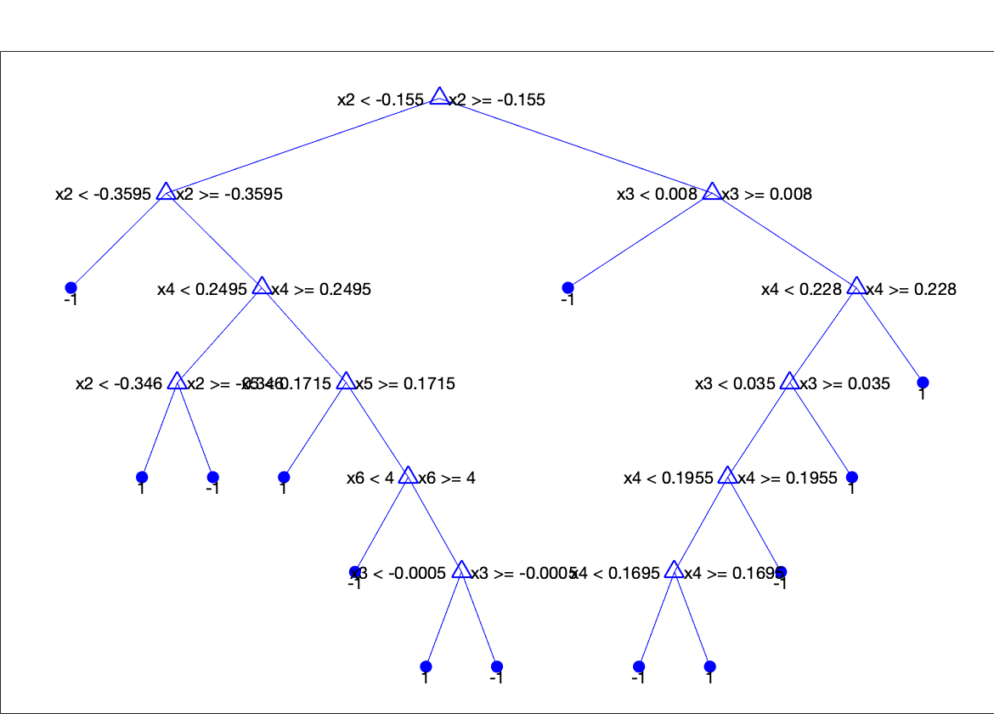
Bagged Tree Ensemble (In Sample)
Confusion Matrix
ans =
122 8
9 291

Slide 10
4. Random Forest
rfX = joined(:,2:7);
rfY = joined(:,9);
rng(1); % For reproducibility
RFor1 = TreeBagger(20, rfX, rfY, 'Method','classification',...
'OOBPrediction','on','NumPredictorsToSample',4);
[label_rf,score_score_rf] = oobPredict(RFor1);
rfZ = num2cell(rfY);
rfZZ=cell2mat(rfZ);
Q=str2double(label_rf);
confusionmat(rfZZ,Q)
view(RFor1.Trees{1},'Mode','graph')

Slide 11
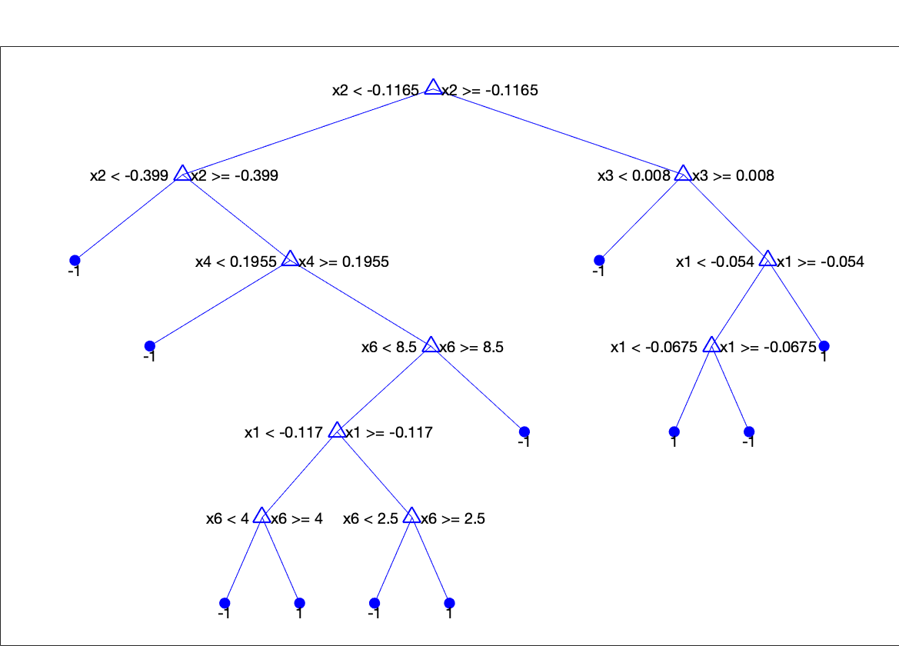
Random Forest (In Sample)
Confusion Matrix
ans =
123 7
6 294

Slide 12
5. Boosted Tree
boostX = joined(:,2:7);
boostY = joined(:,9);
ens_boost = fitcensemble(boostX, boostY, 'Method', 'AdaBoostM1');
labels_boost = predict(ens_boost, boostX);
boostZ=num2cell(boostY);
boostZZ=cell2mat(boostZ);
confusionmat(boostZZ, labels_boost)
view(ens_boost.Trained{1,1},'Mode','graph')

Slide 13
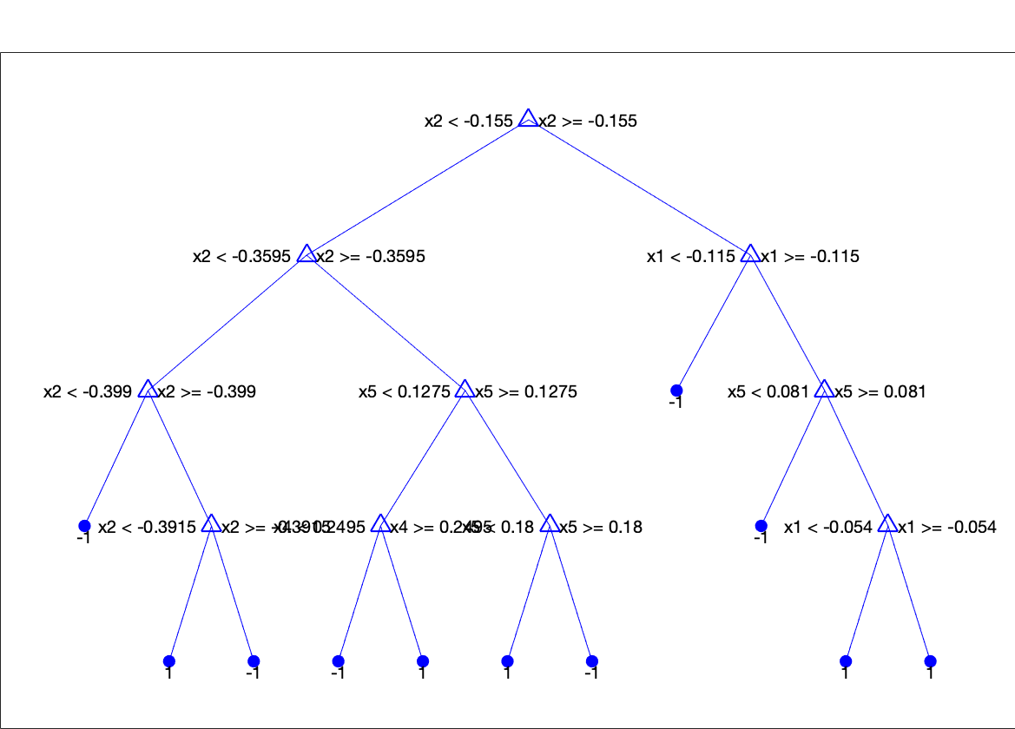
Boosted Tree (In Sample)
Confusion Matrix
ans =
130 0
0 300

Slide 14
Testing
Separate the data:
X_test = testdata(:,2:7);
Y_test = testdata(:,9);

Slide 15
Test for Simple Decision Tree
label_Simple_Tree = predict(SimpleTree.ClassificationTree,X_test);
confusionmat(Y_test,label_Simple_Tree)
ans =
124 6
15 385

Slide 16
Test for Optimized Tree
label_opt = predict(OptTree,X_test);
confusionmat(Y_test,label_opt)
ans =
122 8
7 393

Slide 17
Test for Bagging
label_bag = predict(ens,X_test);
confusionmat(Y_test,label_bag)
ans =
130 0
13 387

Slide 18
Test for Random Forest
label_RF = predict(RFor1,X_test);
label_rf = str2double(label_RF);
confusionmat(Y_test,label_rf)
ans =
130 0
13 387

Slide 19
Test for Boosting
label_boost = predict(ens_boost,X_test);
confusionmat(Y_test,label_boost)
ans =
130 0
13 387

Slide 20
Discussion
Check in-sample results and out-of-sample results.
From in-sample, we see that Simple Decision Tree gives the lowest accuracy, and Optimized Decision Tree gives the next lowest accuracy. The accuracy for the other three methods are pretty much the same.
And we get the same observation for the out-of-sample result.

